Slide 1
ACCESS CONTROL

Slide 2

Learning Objectives for Access Control
Package declaration
Accessibility modifiers
Simple Imports & Static Imports
Input From User

Slide 3
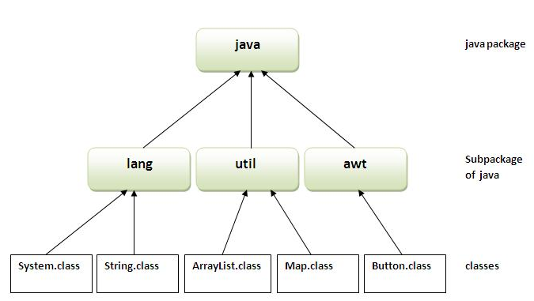
Packages
A package is a namespace that organizes a set of related classes and interfaces. Conceptually you can think of packages as being similar to different folders on your computer. You might keep HTML pages in one folder, images in another, and scripts or applications in yet another.

Slide 4
Access Modifier
Java provides a number of access modifiers to help you set the level of access you want for classes as well as the fields, methods and constructors in your classes. A member has package or default accessibility when no accessibility modifier is specified.
Access Modifiers
1. private
2. protected
3. default
4. public

Slide 5
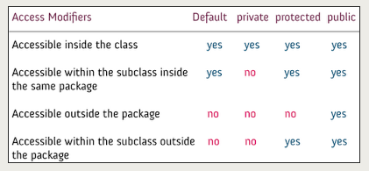
Access Modifier Contd.

Slide 6
Imports
Import keyword is used to import built-in and user-defined packages into your java source file. So that your class can refer to a class that is in another package by directly using its name.
Importing a Package Member
To import a specific member into the current file, put an import statement at the beginning of the file before any type definitions but after the package statement
Importing an Entire Package
To import all the types contained in a particular package, use the import statement with the asterisk (*) wildcard character.

Slide 7
Static Imports
The static import feature of Java 5 facilitate the java programmer to access any static member of a class directly. There is no need to qualify it by the class name.
Advantage of static import
Less coding is required if you have access any static member of a class oftenly.
Disadvantage of static import
If you overuse the static import feature, it makes the program unreadable and unmaintainable.

Slide 8
Input from User
Scanner class
Buffered Reader and InputStreamReader classes

Slide 9
What are we learning in Next Chapter ?
Encapsulation
Inheritance (IS-A Relationship)
Polymorphism
Method Signature
Overloading
Overriding
this or super
Final & static
Abstract class
Interface

Slide 10
Thank You !

